Slide 1
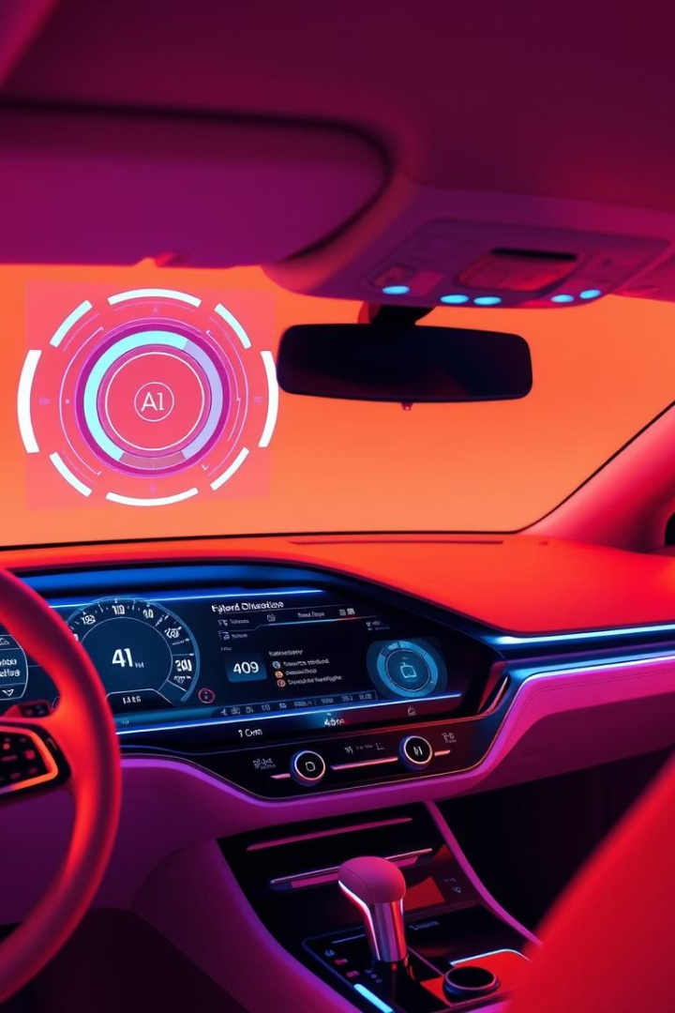
AI-Powered Car Fault Diagnosis App
This presentation outlines the requirement gathering process for an AI-powered car fault diagnosis mobile application. We'll cover stakeholder identification, data collection techniques, data cleaning, and user reluctance assessment. Our goal is to develop an app that meets user needs and provides accurate, accessible car diagnostics.
By Group 19

Slide 2
Stakeholder Identification
Key Stakeholders
Importance
Car Owners/Drivers: Primary end users.
Stakeholder identification ensures the system meets real-world needs, balances priorities, and encourages collaboration. By classifying users and non-user stakeholders, the project can meet functional and non-functional requirements while delivering value to all relevant parties.
Auto Mechanics: Verify app diagnoses.
Software Developers: Handle app implementation.
AI/ML Engineers: Develop and train models.
Car Manufacturers/Investors: Provide data and potential investment.

Slide 3

Requirement Gathering Techniques
1
Surveys
2
Interviews
Gather quantitative data on user habits and preferences. Understand car owners' behavior and challenges related to car maintenance and dashboard light interpretations.
Gain deeper insights into user issues and expert perspectives. Understand what users would like to see in the app.
3
Brainstorming Sessions
Explore features and design decisions for the app. Integrate sound recognition for early detection.

Slide 4
Requirement Gathering Techniques (Cont.)
Reverse Engineering
Objectives
Examine existing apps to learn from their features, technologies, and limitations. Most apps rely on external OBD hardware and do not offer sound-based diagnostics.
Identify user needs and pain points.
Gather qualitative and quantitative insights.
Validate the problem statement.
Analyze existing tools for inspiration.
Uncover hidden requirements.
Ensure comprehensive system requirements.

Slide 5




Survey Key Findings: Car Owners/Drivers
Maintenance
43.8% perform maintenance regularly, 31.3% when a problem arises.
Dashboard Lights
68.8% ask a mechanic for help, 18.8% refer to the car manual.
Engine Sounds
80% unable to get the meaning of strange engine sounds.
Most users are proactive, but a significant number delay maintenance until issues appear. Users overwhelmingly rely on mechanics, indicating a lack of confidence or awareness about dashboard lights. A great majority of the people can’t identify car problems from the engine sounds.

Slide 6
Survey Key Findings: App Preferences
AI Tool
Mechanic Connection
100% of people would like to use an AI tool for car fault diagnoses. Everyone would like a tool like this, so its really going to be a good innovation according to the responses gotten from the people.
31% of the people would like an app that will connect them to a mechanic. A great deal of the people would love to contribute as experts meaning the integration of the feature to link car owners to mechanics will be a great one.

Slide 7
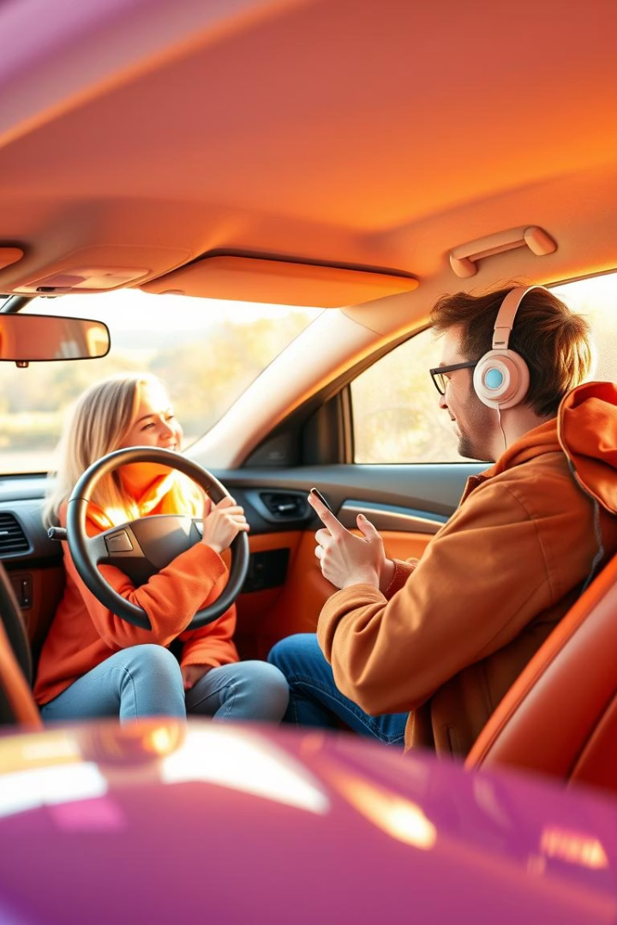
Interview Feedback Highlights
Simplicity
Users want a simple, non-technical application.
Visuals
Prefer visual cues or icons over text.
Trust
Would trust the app more if it links to verified experts/videos.
Offline
Offline functionality would be useful when stranded.

Slide 8
Reverse Engineering: Identifying Gaps
OBD Auto Doctor
Car Scanner ELM OBD2
Sound Analyzer App
AutoMate AI
Real-time diagnostics via Bluetooth OBD. Requires hardware.
Detect frequencies and classify sounds. Not tailored to car issues.
Predict faults via symptoms. Lacks mechanic interaction.
Diagnostic reports, emission tests. Not user-friendly for laypersons.

Slide 9
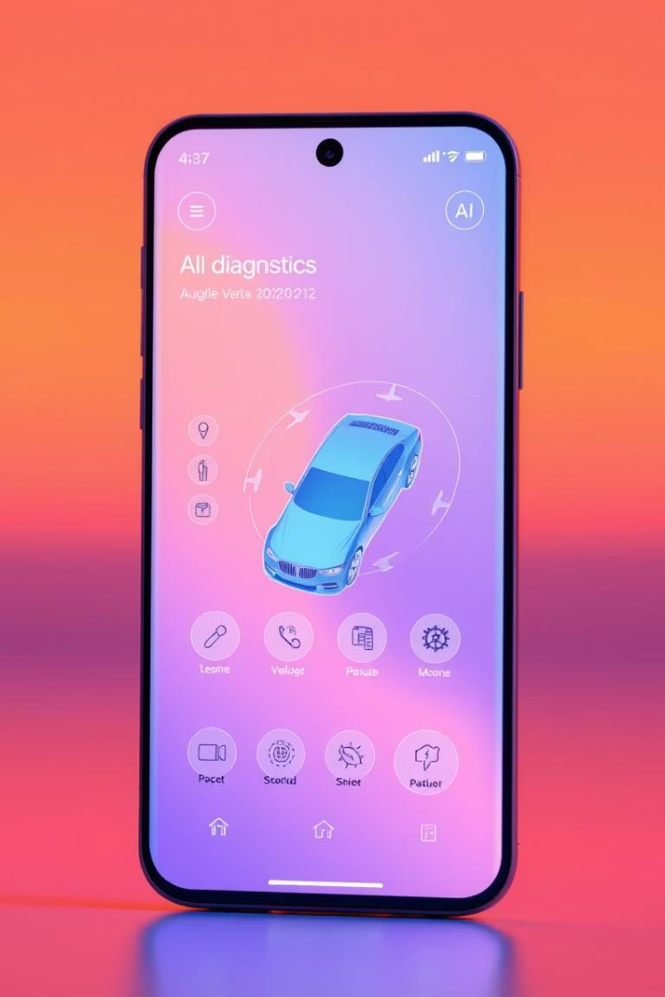



Data Gathering: Understanding User Needs
Online Survey
Interviews
Quantitative insights from car owners, drivers, and mechanics revealed that 68.8% consult a mechanic for dashboard lights, and 80% cannot detect engine faults via sound.
Qualitative context highlighted that most users lack technical knowledge, desire visual guidance, and prefer AI assistance as a second opinion. Offline use is essential.
Brainstorming
Translated user feedback into actionable feature ideas, including YouTube API integration, a mechanic-matching service, and confidence percentage display.

Slide 10

Data Cleaning Process
1
Survey Data
Removed incomplete responses, applied consistent formatting, grouped text answers, and checked for duplicate entries.
2
Interview Data
Removed noise and off-topic remarks, merged repeated comments.
3
Brainstorming Data
Grouped similar ideas, classified features, and filtered out impractical concepts.
4
Reverse Engineering Data
Extracted feature sets, identified gaps, and mapped to user needs.

Slide 11




User Reluctance Assessment
Technical Skills
Use a very simple interface with guidance.
Privacy Concerns
Add clear privacy policies and permissions.
Distrust in Accuracy
Use AI with a good accuracy rate and show confidence levels.
Preference for Mechanics
Position the app as a “first check” tool.
User reluctance assessment is about understanding why users might hesitate or refuse to use your mobile application, even if it’s helpful. It helps you discover barriers to adoption so you can fix or reduce them early in your design.

Slide 12

Key Takeaways
User-Centric Design
Trust and Accuracy
Focus on simplicity, visual cues, and offline functionality.
Ensure high AI accuracy and transparency.
Mechanic Integration
Offer a mechanic connection feature for expert assistance.
The survey and interview results strongly validate the need for this app. There's a clear demand for a mobile-first, AI-powered tool that enables users to diagnose dashboard alerts and engine sounds, gain confidence in car maintenance, and reduce dependency on physical mechanics for basic issues.

